Slide 1
VMTS Mobile Automation Proof Of Concept -Vishwanand
Engineering Services, Infosys
Feb 2017

Slide 2
AGENDA….
Objective
Proposed solution
Future scope
Challenges
Demo

Slide 3
Objective
Use Test automation to reduce human effort in testing activity, hence saving time and money
Improving Test accuracy
Testing with simulated users
Functional and Regression Testing of Virgin TV kids app
Testing the app on a wide range of devices without acquire them

Slide 4
Proposed solution
Use Appium to automate the Test cases
Appium is an open source test automation tool for mobile applications
Appium is “cross-platform” it allows you to write tests against multiple platforms (iOS, Android, Windows),
using the same API.
Appium Concepts
Client/Server Architecture
Session
Desired Capabilities
Appium Server
Appium Clients

Slide 5
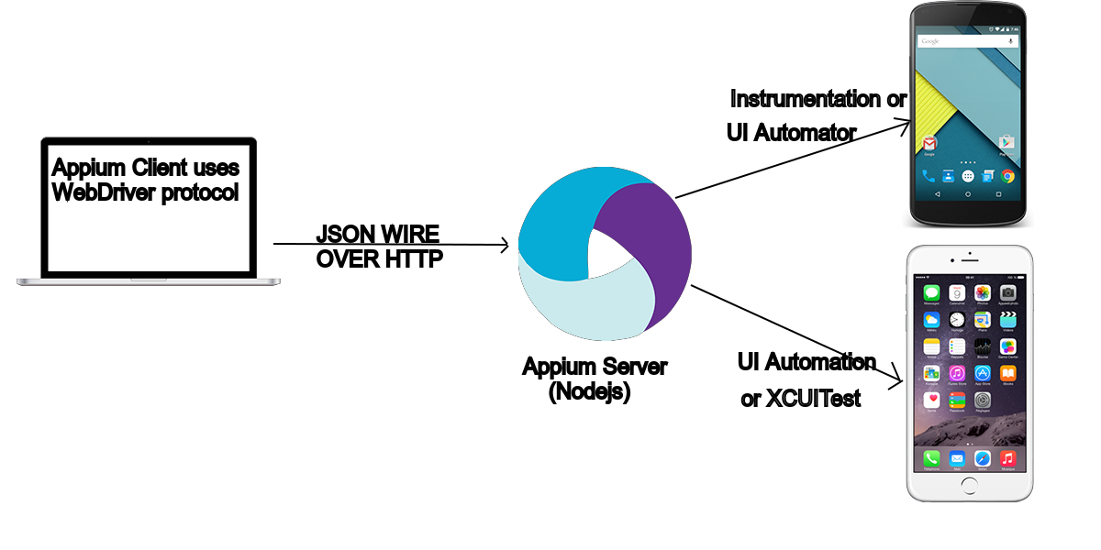
Client/Server Architecture

Slide 6
Sauce Labs
Sauce Labs acquired TestObject to expand the mobile testing capabilities with their advanced real device platform.
Sauce offers the automated and manual testing solution on the market for web and
mobile applications.
The Sauce Labs real device cloud provides the ability to run either manual or automated tests across
Android and iOS devices, in either a private or public cloud
Manual testing on real devices
Private and public real device clouds
Support for Appium .
Support on hundreds of device-OS combinations
Devices cleaning process between sessions to ensure maximum privacy

Slide 7
Future scope/ Challenges
Continuous Integration tool
Test Reporting
Recording UI components
Test Object does not have it’s own scripting mechanism

